Slide 1
COMMON THYROID GLAND DISORDERS
HUMPHREY M.
BSC.N

Slide 2
objectives
By the end of the session you should be able to know :
Causes of thyroid gland disorders
Signs and symptoms of common thyroid conditions
The management of these conditions

Slide 3
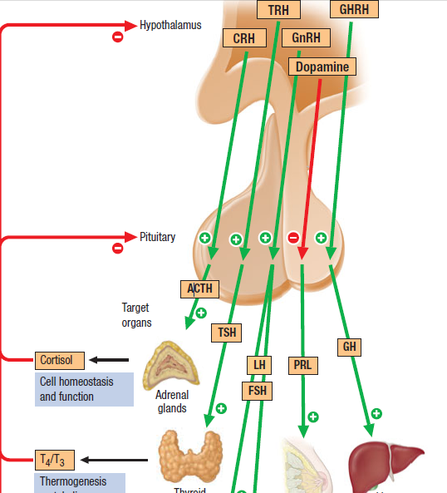
OUTLINE OF THE ENDOCRINE SYSTEM

Slide 4
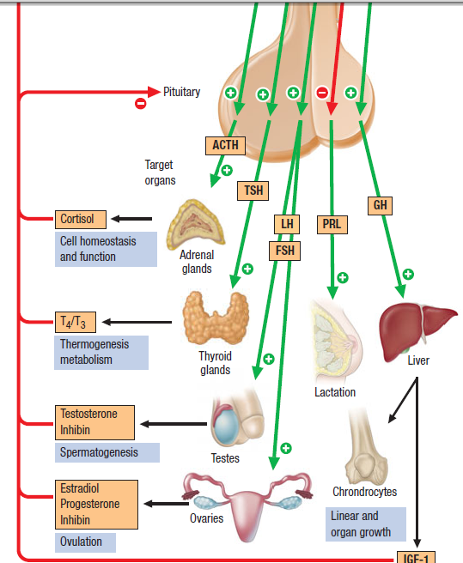

Slide 5
Causes of thyroid diseases
Autoimmune disease - are characterized by the presence of specific antibodies in the serum.
Often present years before clinical symptoms are evident
2. Thyroid tumors -Hormone-secreting tumors.
Fortunately, they are more commonly benign than malignant.

Slide 6
Causes Ct’d
Enzymatic defects - The biosynthesis of most hormones involves many stages. Deficient or abnormal enzymes can lead to absent or reduced production of the secreted hormone.
4. Receptor abnormalities - Hormones work by activating cellular receptors.
Hormone secretion and control are normal but the receptors are defective

Slide 7
SPECIFIC THYROID GLAND ABNORMALITIES
HYPOTHYROIDISM
Occurs due to under activity of the thyroid gland.
Is usually primary, from disease of the thyroid, but may be secondary to hypothalamic-pituitary disease (reduced TSH drive)
Primary hypothyroidism
Mainly auto immune -Atrophic (autoimmune) hypothyroidism

Slide 8
CT’D
Is the most common cause of hypothyroidism and is associated with antithyroid autoantibodies which block the TSH receptor leading to eventual atrophy of the gland.
Is six times more common in females and the incidence increases with age.
Is associated with other autoimmune disease e.g pernicious anaemia, vitiligo.

Slide 9
Causes of hypothyroidism
Congenital Agenesis
Defects of hormone synthesis
iodine deficiency
Antithyroid drugs
Others: drugs (e.g. lithium, amiodarone, interferon)
Autoimmune
Atrophic thyroiditis
Hashimoto's thyroiditis
Infective thyroiditis
Post-surgery
Post-irradiation -Radioactive iodine therapy OR External neck irradiation
Hypopituitarism Isolated TSH deficiency

Slide 10
Clinical features of hypothyroidism
Myopathy leading to extreme fatigue thus limiting usual activities.
Reports of dry-hair, hair loss, brittle nails, and dry skin are common.
Numbness and tingling of the fingers may occur.
Deep voice as patient may complain of hoarseness.
Menstrual disturbances e.g menorrhagia or amenorrhea occur, in addition to loss of libido.
Severe hypothyroidism results in a subnormal body temperature i.e cold intolerance. Complains of being cold even in warm environment.

Slide 11
Clinical manifestations ct’d
The patient usually begins to gain weight even without an increase in food intake,
Pulse rate below the normal range i.e Bradycardia
Constipation
Children with hypothyroidism may not show classic features but often develop cretinism which presents with:
Slow growth velocity
Poor school performance
Arrest of pubertal development.

Slide 12
Clinical manifestations ct’d
Advanced hypothyroidism may produce personality and cognitive changes characteristic of dementia.
Severe hypothyroidism is associated with an elevated serum cholesterol level, atherosclerosis, coronary artery disease, and poor left ventricular function.
ASSIGNMENT: READ AND MAKE SHORT NOTES ON MYXEDEMA COMA (SEVERE HYPOTHYROIDISM)

Slide 13
Diagnosis of Myxoedema coma
Serum TSH is the investigation of choice; a high TSH level confirms primary hypothyroidism.
A low free T₄ level confirms the hypothyroid state
Thyroid antibodies may be present.
Other abnormalities include:
Anaemia
Hypercholesterolemia

Slide 14
MYXOEDEMA COMA (SEVERE HYPOTHYROIDISM)
Myxoedema coma -Severe hypothyroidism-may present with confusion or even coma , but the symptoms usually include:
Hypothermia
Severe cardiac failure
Hypoventilation
Hypoglycemia
Hyponatremia.

Slide 15
MANAGEMENT OF HYPOTHYROIDISM
Medical management
GOAL: Restore the normal metabolic state by replacing the missing hormone.
T₃ orally or intravenously in doses of 2.5-5 μg every 8 hours
Oxygen (by ventilation if necessary)
Monitoring of cardiac output
Gradual rewarming
Hydrocortisone 100 mg i.v. 8-hourly
Glucose infusion to prevent hypoglycemia

Slide 16
Medical Management ct’d
Replacement therapy with levothyroxine (thyroxine- T₄) is given for life to restore T₄ and TSH to well within the normal ranges
If serum TSH remains high, the dose of T₄ should be increased in increments of 25-50 μg and the tests repeated 6 weeks later
Patients who have undergone thyroid surgery or received radioiodine should have regular thyroid function tests

Slide 17
Nursing management of hypothyroidism
Provision of health education and support to the family on managing this complex disorder at home.
Oral and written instructions should be provided regarding the following:
Desired actions and side effects of medications
Correct medication administration
Importance of continuing to take the medications as prescribed even after symptoms improve
When to seek medical attention
Importance of nutrition and diet to promote weight loss and normal bowel patterns
Importance of periodic follow-up testing
The patient and family should be informed that many of the symptoms observed during the course of the disorder will disappear with effective treatment

Slide 18
FOR MORE NURSING INTERVENTIONS REFER TO TEXBOOK OF MEDICAL-SURGICAL NURSING BY BRUNNER AND SUDDARTH.

Slide 19
HYPERTHYROIDISM
Is the second most prevalent endocrine disorder, after diabetes mellitus.
Graves’ disease, the most common type of hyperthyroidism that results from an excessive output of thyroid hormones caused by abnormal stimulation of the thyroid gland by circulating immunoglobulins.
8 times more frequent in women than men, with onset usually between 20 and 40 years of age.
The disorder may appear after an emotional shock, stress, or an infection.
Other common causes of hyperthyroidism include thyroiditis and excessive ingestion of thyroid hormone.

Slide 20
Extrathyroidal sources of thyroid hormone e.g struma ovarii, functioning follicular carcinoma also lead to the disorder.
Secondary hyperthyroidism results from TSH-secreting pituitary adenoma, human chorionic gonadotropin (hCG)-secreting tumors and gestational thyrotoxicosis].

Slide 21
CLINICAL MANIFESTATIONS OF HYPERTHYROIDISM
Patients with well-developed hyperthyroidism exhibit a characteristic group of S&S referred to as thyrotoxicosis.
The presenting symptom is often nervousness.
These patients are often emotionally hyperexcitable, irritable, and apprehensive; they cannot sit quietly; they suffer from palpitations; and their pulse is abnormally rapid at rest as well as on exertion.
They tolerate heat poorly and perspire unusually freely.
A fine tremor of the hands may be observed.
Patients may exhibit ophthalmopathy e.g exophthalmos (bulging eyes) which despite treatment, are not always reversible.

Slide 22
CLINICAL MANIFESTATIONS CT’D
Other manifestations include:
An increased appetite and dietary intake, progressive weight loss, abnormal muscular fatigability and weakness (difficulty in climbing stairs and rising from a chair).
Amenorrhea, and changes in bowel function leading to diarrhoea
Cardiac effects may include sinus tachycardia or dysrhythmias, increased pulse pressure, and palpitations.
Myocardial hypertrophy and heart failure may occur if the hyperthyroidism is severe and untreated.

Slide 23
Clinical manifestations of hyperthyroidism (SUMMARY)
Nervousness
Irritability
heat intolerance,
excessive sweating
palpitations
fatigue and weakness
weight loss with increased Appetite
frequent bowel movements
oligomenorrhea.
anxious, restless, and fidgety
Skin is warm and moist
fingernails may separate from the nail bed
Eyelid retraction and lid lag may be present exophthalmos
Cardiovascular findings include tachycardia, systolic hypertension, systolic murmur, and atrial fibrillation.
A fine tremor, hyperreflexia, and proximal muscle weakness

Slide 24
NOTE: Children frequently present with:
excessive height or excessive growth rate, or with behavioral problems such as hyperactivity.
They may also show weight gain rather than loss.

Slide 25
ct
GRAVES’ DISEASE:
The thyroid is usually diffusely enlarged to two to three times its normal.
Usually associated with toxic adenoma or toxic multinodular goiter.
Thyrotoxic crisis, or thyroid storm occurs and presents as a life-threatening exacerbation of hyperthyroidism, and can be accompanied by fever,vomiting and diarrhea delirium, seizures, arrhythmias, coma

Slide 26
DIAGNOSITIC FINDINGS
In advanced cases, the diagnosis is made on the basis of the symptoms, a decrease in serum TSH, increased free T4, and an increase in radioactive iodine uptake.
Serum TSH is a sensitive marker of Thyrotoxicosis-LOW TSH
Thyroid hormones test-HIGH T4,T3
The thyroid gland is enlarged to some extent, It is soft and may pulsate.

Slide 27
MANAGEMENT OF GRAVE’S DISEASE (THYROTOXICOSIS/HYPERTHYROIDISM)
Treatment is directed toward reducing thyroid hyperactivity to relieve symptoms and preventing complications.
Use of radioactive iodine is the most common form of treatment for Graves’ disease.
Graves’ disease may also be treated with antithyroid drugs
The main antithyroid drugs are methimazole or carbimazole (10–20 mg two to three times a day.
Propylthiouracil (100–200 mg every 8 h initially,
NOTE:Thyroid function tests should be checked 3–4 weeks after initiation of treatment, with adjustments to maintain a normal free T4
Subtotal thyroidectomy is rarely indicated.

Slide 28
MGT OF HYPERTHYROIDISM CT’D
Use of irradiation by administration of the radioisotope iodine provides destructive effects on the thyroid gland
(2) Antithyroid medications interfere with the synthesis of thyroid hormones and other agents that control manifestations of hyperthyroidism.
Surgery is done to remove thyroid tissue . Today, surgery is reserved for special circumstances—e.g in pregnant women who are allergic to antithyroid medications, in patients with large goiters, or in patients who are unable to take antithyroid agents.
Use of beta adrenergic blockers for symptomatic control. EXAMPLE????

Slide 29
Q/N: WHAT ARE THE NURSING INTERVENTIONS FOR A PATIENT WITH HYPERTHYROIDISM/THYROTOXICOSIS/THYROID STORM??
HINT: Improving nutritional status of the patient
Enhancing coping measures of the patient
Improving self esteem of the patient
Maintaining normal body temperature
Monitoring and managing potential complications
Promoting home and community based care
N/B: USE THE NURSING PROCESS IN THE MANAGEMENT OF THE PATIENT.

Slide 30
ASSIGNMENT
READ AND MAKE SHORT NOTES ON:
THYROIDITIS
GOITER
THYROID TUMOURS

